Slide 1

TRAVEL AND TOURISM
Major Project - II
CS- 805
Problem Statement : Despite the global growth in travel and tourism, the industry continues to face several persistent challenges that affect both travelers and service providers. Travelers often struggle with discovering personalized and reliable travel options, navigating unfamiliar locations, managing bookings across multiple platforms, and accessing real-time information during their trips.
Project Group Number: 38
Group Member Details:
Piyush Kumar – 0187CS211115
Piyush Pandey – 0187CS211116
Guide Details: Prof. Nargish Gupta

Slide 2
Idea/Approach Details
Abstract:
The travel and tourism industry is a vital contributor to global economic growth, cultural exchange, and social development. However, travelers often encounter challenges such as fragmented booking systems, lack of personalized recommendations, language barriers, and limited access to real-time information.
Describe your idea Solution/Prototype here:
Despite the global growth in travel and tourism, the industry continues to face several persistent challenges that affect both travelers and service providers. Travelers often struggle with discovering personalized and reliable travel options, navigating unfamiliar locations, managing bookings across multiple platforms, and accessing real-time information during their trips.
Describe your Technology stack here:
React.JS
CSS3
Bootstrap
Node & Express JS
MongoDB
Python

Slide 3
Project Feature
Cultural Exchange: Travelers experience different cultures, traditions, and ways of life.
Recreation and Leisure: Tourism provides opportunities for relaxation, entertainment, and enjoyment.
Exploration: Travelers discover new destinations, landmarks, and attractions.
Economic Impact: Tourism generates revenue, creates jobs, and stimulates local economies.
Diversity: Tourism encompasses various types, such as adventure, eco-tourism, cultural, historical, and luxury tourism
Adventure Tourism: Activities like hiking, skiing, and water sports.
Eco-Tourism: Responsible travel to natural areas, promoting conservation and sustainability.
Cultural Tourism: Exploring local culture, traditions, and heritage.
Historical Tourism: Visiting historical sites, landmarks, and monuments.
Luxury Tourism: High-end travel experiences, often featuring luxury accommodations and services.

Slide 4
Project Requirements
Hardware and Software requirements (Developer)
Hardware and Software requirements (Client)
Development Machines: High-performance desktop or laptop computers to write , test and debug code.
Storage: Adequate storage solutions for storing applications data and backups.
Testing and Quality Assurance Tools: Testing frameworks and continuous integration tools.
Database Management System: Identify the database system used, for example, MySQL.
Programming Languages: List of the languages used in the development of the projects, like React.js, Node.js Python.
Device: Any internet-enabled device such as desktop computer, laptop, tablet, or smartphones.
Internet Connectivity: Stable and reliable internet connectivity to access the car rental service online.
Web Browser: Modern, up-to-date web browsers that support the latest web technologies. Example: Google Chrome, Microsoft Edge.
Communication Tools: Any necessary communication tools for customer support or inquiries, Example: email clients, messaging apps.

Slide 5

Project Requirements
Functional Requirements
Non-Functional Requirements
User Authentication (MFA): Users securely log in/signup using email, phone, or social accounts. Multi-factor authentication (MFA) ensures security by requiring an additional verification step, like OTP or biometrics.
Profile Management: Users can create, edit, and update their profiles, including personal details, skills, experience, and resumes.
Notifications System: Users receive real-time notifications via email, SMS, or app alerts about job updates, interview schedules, application status, and employer messages for seamless communication.
Performance: This software is able to handle a large number of users and requests without slowing down.
Reliability: Software is reliable and available to users when they need it.
Security: Software secures and protects user data from unauthorized access.
Scalability: Software is scalable to accommodate a growing number of users and classes.
Usability: Software is easy to use and navigate for both gym members and staff.
Maintainability: Software is easy to maintain and update.
5
5

Slide 6
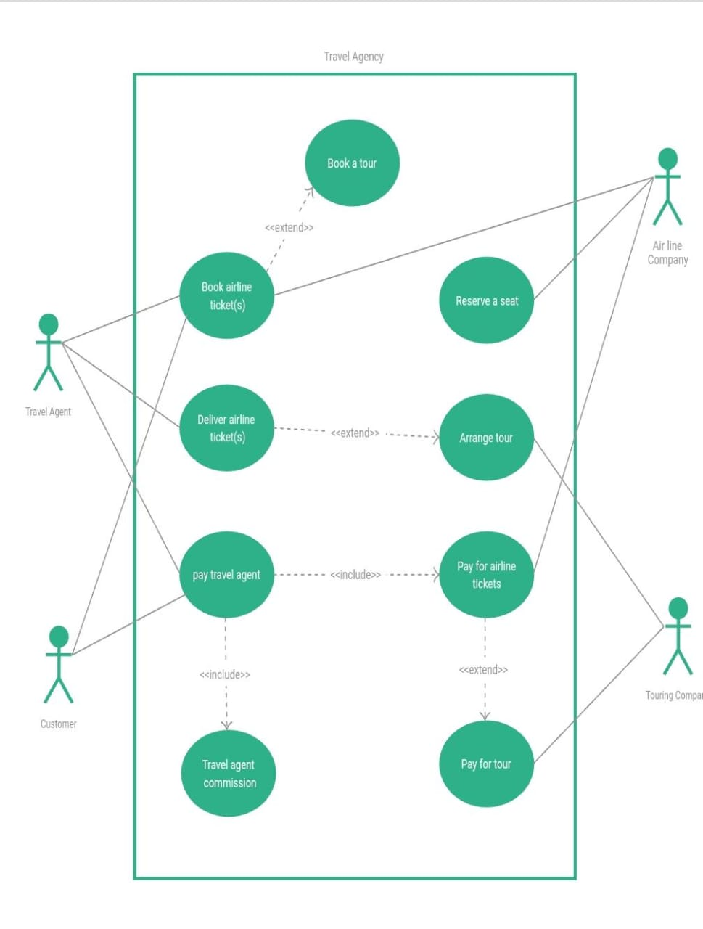
Design

Slide 7
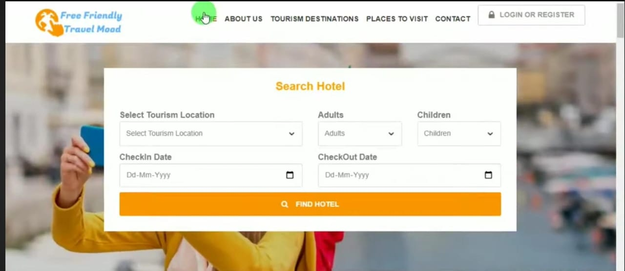
Screen Short

Slide 8


